Slide 1
Accessible Security
CS5472 Final Project Presentation
Trevor Hornsby

Slide 2
Introduction
Problem – Popular security solutions are often oversimplified / vaguely informative
Limited visibility into what it’s doing to protect you
No knowledge of coverage gaps unless there’s a paid version
Few opportunities for users to learn about their specific security situation
Solution – Created a Proof-of-Concept security product that fixes these issues using Python
Allows users to take control of their own security
Full visibility into your security
Ability for the user to learn more about their security issues

Slide 3
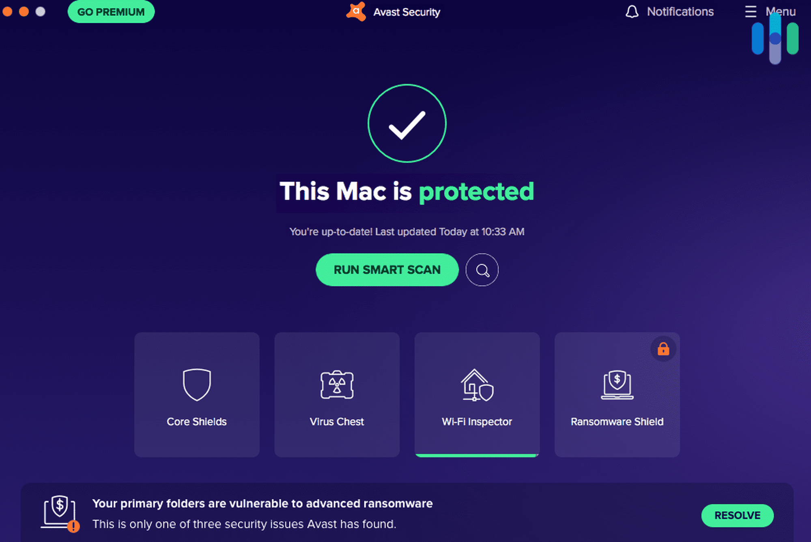
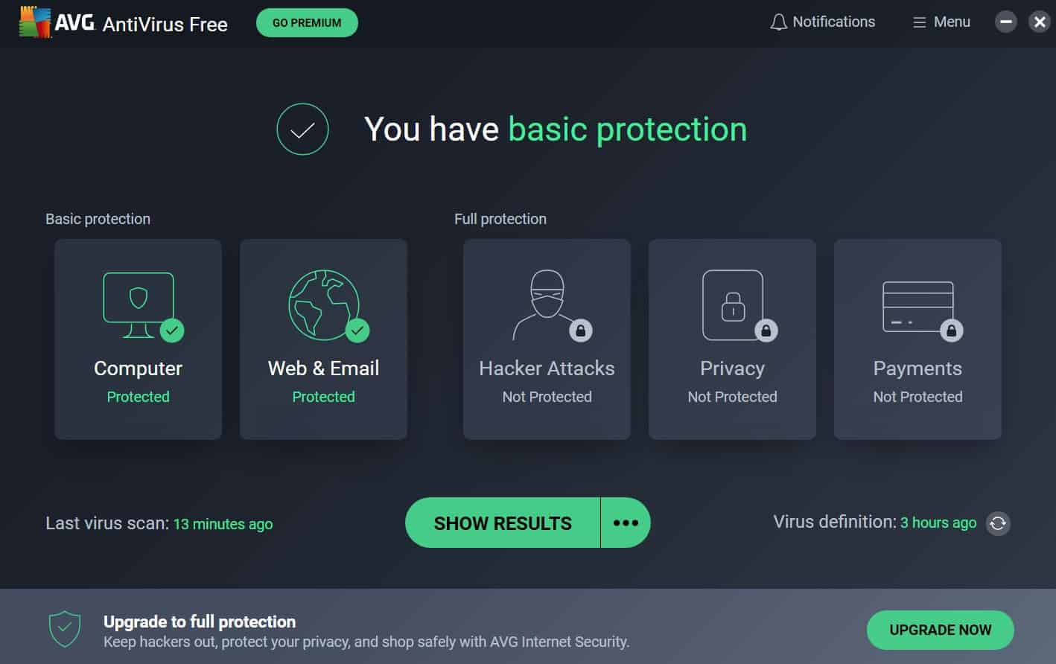
Examples of Current Solutions
https://www.security.org/app/uploads/2020/12/Avast-Antivirus-Mac-is-Protected-Screenshot.png https://www.security.org/app/uploads/2020/12/AVG_You-Have-Basic-Protection.jpg

Slide 4
Past Research
Gamification [1]
Usability – levels can help users get comfortable using advanced features of a product
Trust – badges and achievements gives users a sense of accomplishment and interaction
Motivation – points can be used to motivate positive actions
On Cybersecurity Education for Non-Technical Learners [2]
Everyone needs a baseline amount security education in order to keep themselves protected
Security concepts and education need to be accessible and understandable to everyone

Slide 5
Design
Simple, easy-to-use and easy-to-read security application. Give users insight and context into how they can improve their own security
Used a raw points and a percentage / grade system to give the user a sense of their current standing
Output has 3 sections
Overall information – total score, date run, security grade
Positive practices – what is the user doing right
Negative practices – what does the user need to fix
Positive and Negative practices
Four Columns: Points impact, security type / category, detailed description, link to more information and instructions
Color coded for impact reinforcement

Slide 6
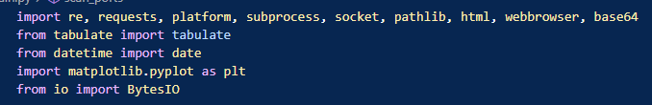
Implementation
Python
Three core functionalities
Collect data (HTTP Requests, Commands, Port Scanning)
Parse data, compare values to known best practices, change score, append output text and relevant URL
Generate, save, and open the report

Slide 7
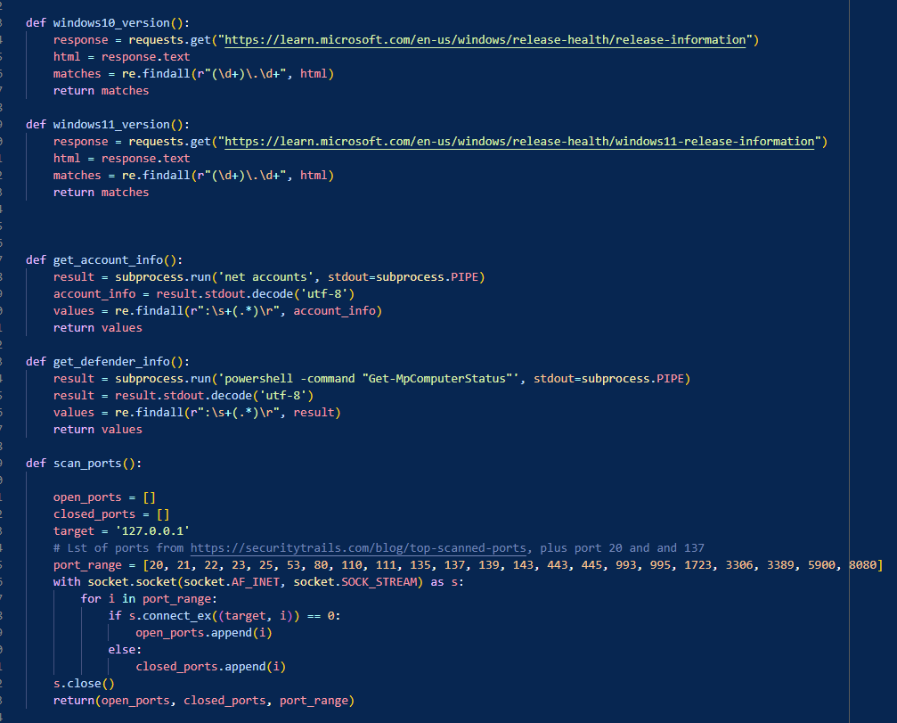
Data Collection

Slide 8
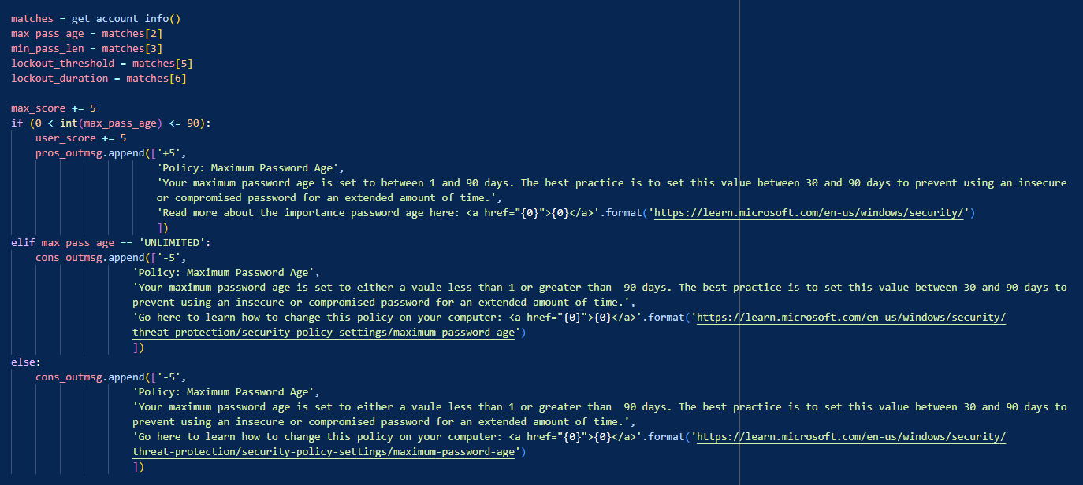
Evaluating Data

Slide 9
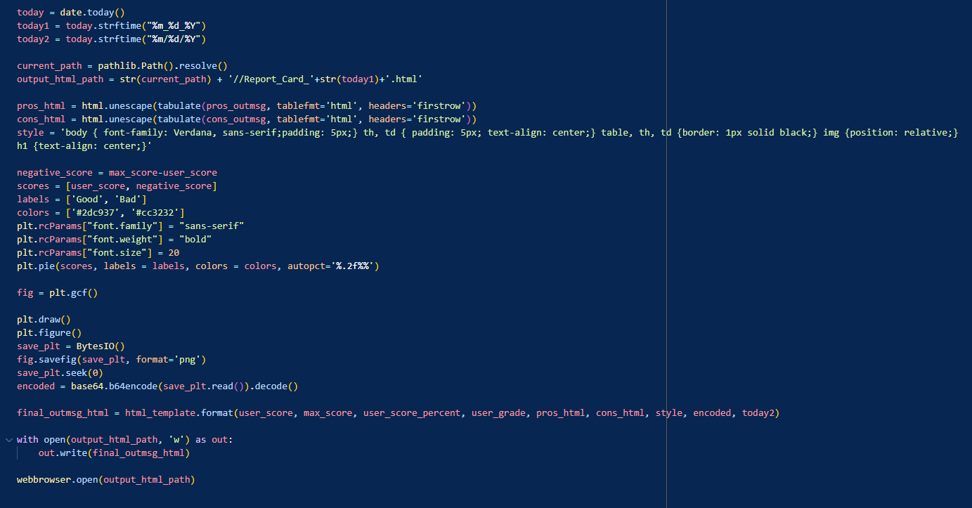
Report Generation

Slide 10
Evaluation
Successfully completed the three core functionalities
Data is collected efficiently
Known best practices are hard-coded into the comparisons
HTML report opens automatically
Scoring is provided in three ways
Easy for user to comprehend their current situation and where / how they can improve
User points / total points
Letter grade and percentage of points earned
Color-coded pie chart showing how big the security gaps really are

Slide 11
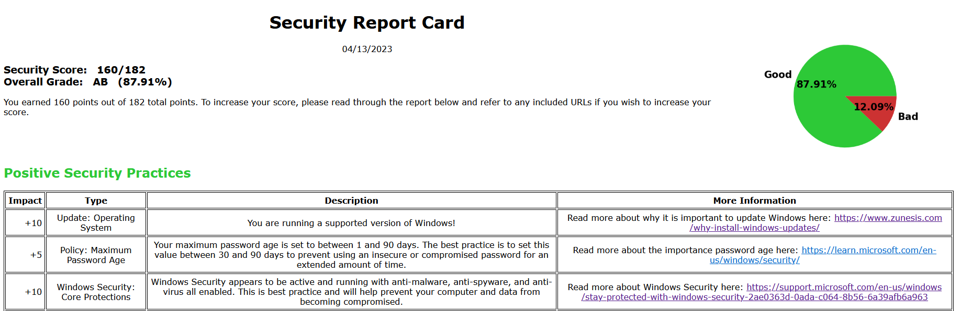
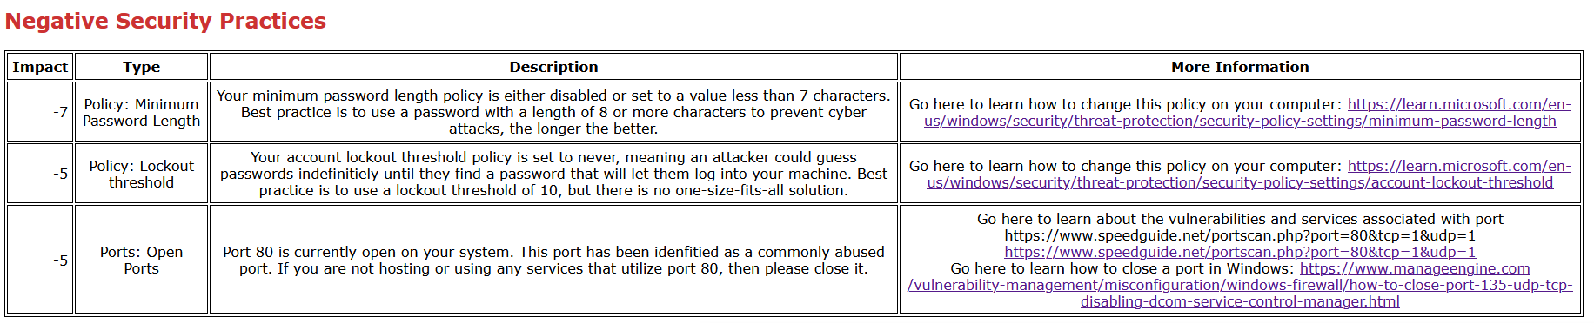
11

Slide 12
Future Work
Automate security patching
Use GPO / commands to close ports, change policies, update windows, etc.
Add more security categories to query and evaluate
Create a more aesthetically pleasing HTML report design
Improve scoring to be more dynamic and case-by-case
Tune scoring to have well-defined weights
Integrate with automation
Allow user to configure what they want to have scanned

Slide 13
Takeaways
From reading the paper on security education [2], making security education tools accessible and easy to use will be a growing problem as ransomware and other advanced threats continue to emerge and develop
Difficult to balance technical features and usability features
Designing something that both looks user friendly and functions well at a technical level takes a large amount of effort
Microsoft does not automatically implement their own best practices for password policies

Slide 14
Conclusion
Main Contributions:
Created a user-controlled security appliance
Give users visibility into their own security
Allow users to educate themselves about security
Successfully implemented gamification concepts
Risk and impact are easy for anyone to interpret and understand
Encourages positive security practices
GitHub: https://github.com/tjhornsb/CS5472_Final_Project

Slide 15
Questions

Slide 16
Citations
[1] D. Basten, “Gamification,” IEEE software, vol. 34, no. 5, pp. 76–81, 2017, doi: 10.1109/MS.2017.3571581. https://ieeexplore.ieee.org/document/8048643
[2] M. McNulty and H. Kettani, "On Cybersecurity Education for Non-technical Learners," 2020 3rd International Conference on Information and Computer Technologies (ICICT), San Jose, CA, USA, 2020, pp. 413-416, doi: 10.1109/ICICT50521.2020.00072. https://ieeexplore.ieee.org/document/9092220

